Slide 1

Eureka

Slide 2

Agenda
Understanding the problem
Eureka under the hood
Netflix Eureka
Hands-on

Slide 3

1
Understanding the problem

Slide 4
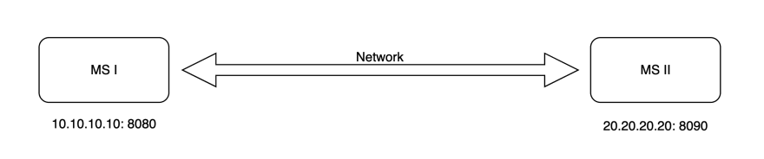
Understanding the problem

Slide 5
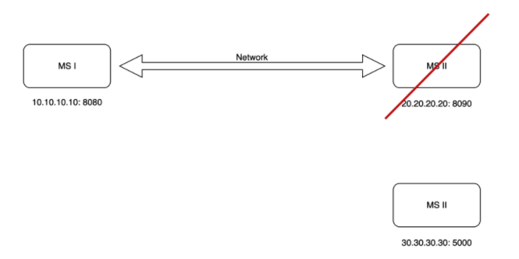
Understanding the problem

Slide 6
Why Hardcoding URL Is Wrong?
Changes require code updates
Dynamic URL in the cloud
Load balancing - If we spin up multiple instances, each instance might have different URLs and it is very inefficient to hardcode the URLs of instances as well
Multiple environments
Understanding the problem
So, we need a system that somehow always discovers the updated and current URL of the service. This process is called Service Discovery.
Eureka by Netflix is a tool used for this service discovery that they have open-sourced.
Notes:
Changes require code updates — If one microservice address has changed, then it has to be updated in all the other microservices that are in contact with it.
Dynamic URL in the cloud — When we deploy on the cloud we get dynamic URLs, and it changes if we stop and start the server again or deploy it elsewhere. We need to accommodate the change, we can’t predict the URL changes.
Load balancing — If we spin up multiple instances, each instance might have different URLs and it is very inefficient to hardcode the URLs of instances as well.
Multiple environments — The URLs change in each phase of the software engineering process, i.e. the URLs might be different during development, QA testing, and production. We can’t change the hardcoded URLs each time.

Slide 7
1
Netflix Eureka

Slide 8
Eureka mainly consists of main components:
Eureka Server: It is an application that contains information about all client service applications. Each microservice is registered with the Eureka server and Eureka knows all the client applications running on each port and IP address. Eureka Server is also known as Discovery Server.
Eureka Client: It's the actual microservice and it registers with the Eureka Server, so if any other microservice wants the Eureka Client’s address then they’ll contact the Eureka Server. All operations with Eureka Client may take some time to be reflected on Eureka Server, and then on other Eureka Clients.
Netflix Eureka

Slide 9
1
Eureka under the hood
Notes:
Chapter Intro Slide (version I)
This slide should be used at the beginning of each “chapter” of your presentation (as introduced in the Agenda slide) to keep the audience aware of their place in the story and to help break things up. Change the text and chapter number accordingly. If you do not need a sub-head (the smaller text), delete it. Use different backgrounds for different chapter titles, try not to repeat a background.
Very short presentations (< ~10 slides) may not need Chapter Intro Slides.
There are multiple versions of this template with various white and black background images starting on slide 10.

Slide 10
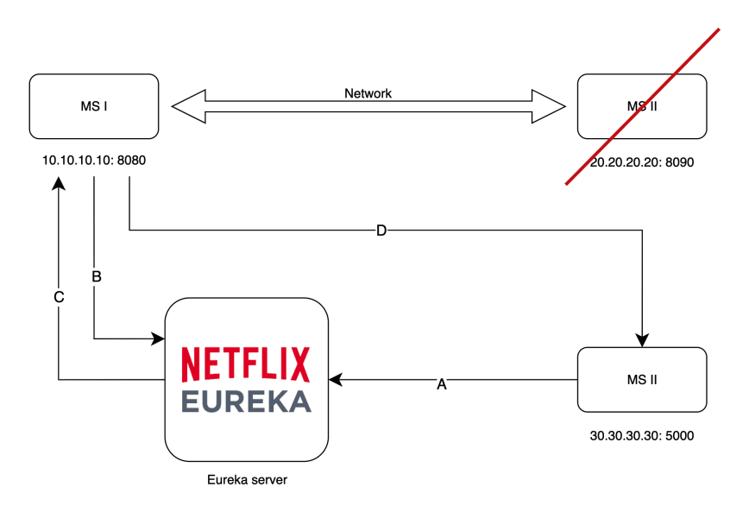
Eureka under the hood
Notes:
The first thing MS2 will do is to register to the naming registry server (Eureka server) providing mainly its IP, port and status (UP or DOWN). [A]
Before MS1 makes the call to MS2 [D], it will fetch the MS2 coordinates from the naming registry [B] which will allow the communication to happen even if MS2 changes its location a million times as long as its registers to the Eureka server. The server will respond with the required data. [C]
You should also understand that by fetching the naming registry or registering to it, the micro-service becomes its client (Eureka client).

Slide 11
1
Hands-on

